Slide 1






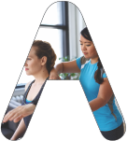



Joanna Choi | Dwayne McFarlane | Jackie Rider | Simone Tobias
Notes:
INTRODUCTION: JACKIE

Slide 2

PT Personalized!
Rehabilitate, recover, and get lasting relief from pain through personalized exercise regimens and ongoing support from your own physical therapist - all with your smartphone.
Joanna Choi | Dwayne McFarlane | Jackie Rider | Simone Tobias
Notes:
INTRODUCTION: JACKIE

Slide 3
Screener Survey
Statistics
Gender: 5 women, 1 man
Age: 25 - 72
Chronic pain related PT: 3
Injury related PT: 3
Frequency: 1 - 3 times/week for 1-6 months
Questions
How did you track your PT progress?
How often did you do the PT exercises at home?
Did you experience pain during/after your PT session?
Choi | McFarlane | Rider | Tobias

Slide 4
User Interviews
Clinic Experience
Staff was welcoming.
I found the clinic evaluation very informative.
3 had positive experiences.
I received exercise printouts.
Home Experience
I had no support.
I received no feedback or progress update.
I couldn’t follow my progress at home.
I was unsure if I was doing them correctly, so I stopped exercises and didn’t improve.
Choi | McFarlane | Rider | Tobias

Slide 5
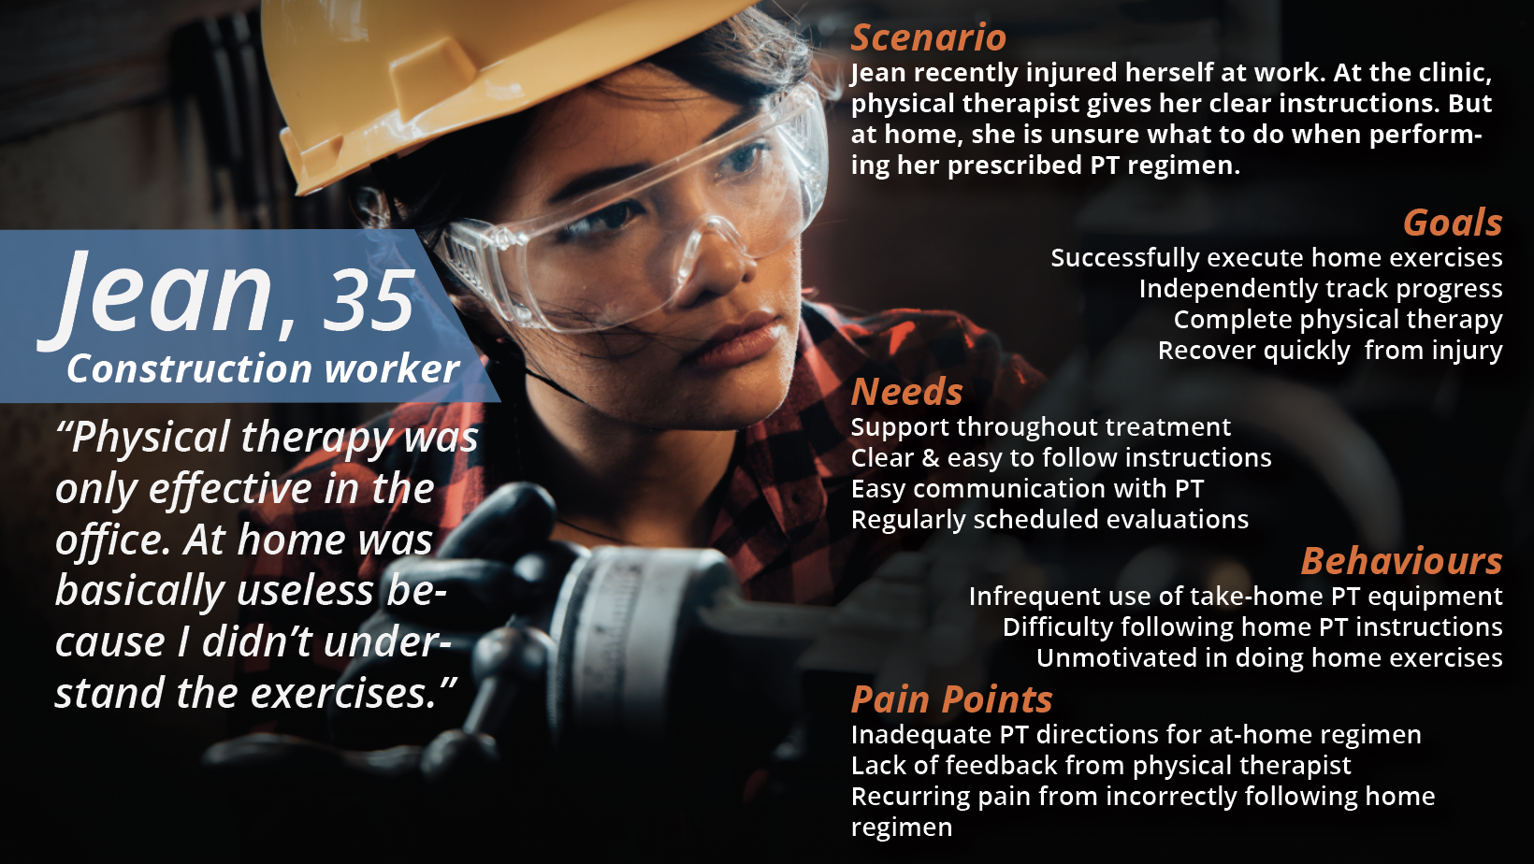
Notes:
SPEAKER: JACKIE

Slide 6
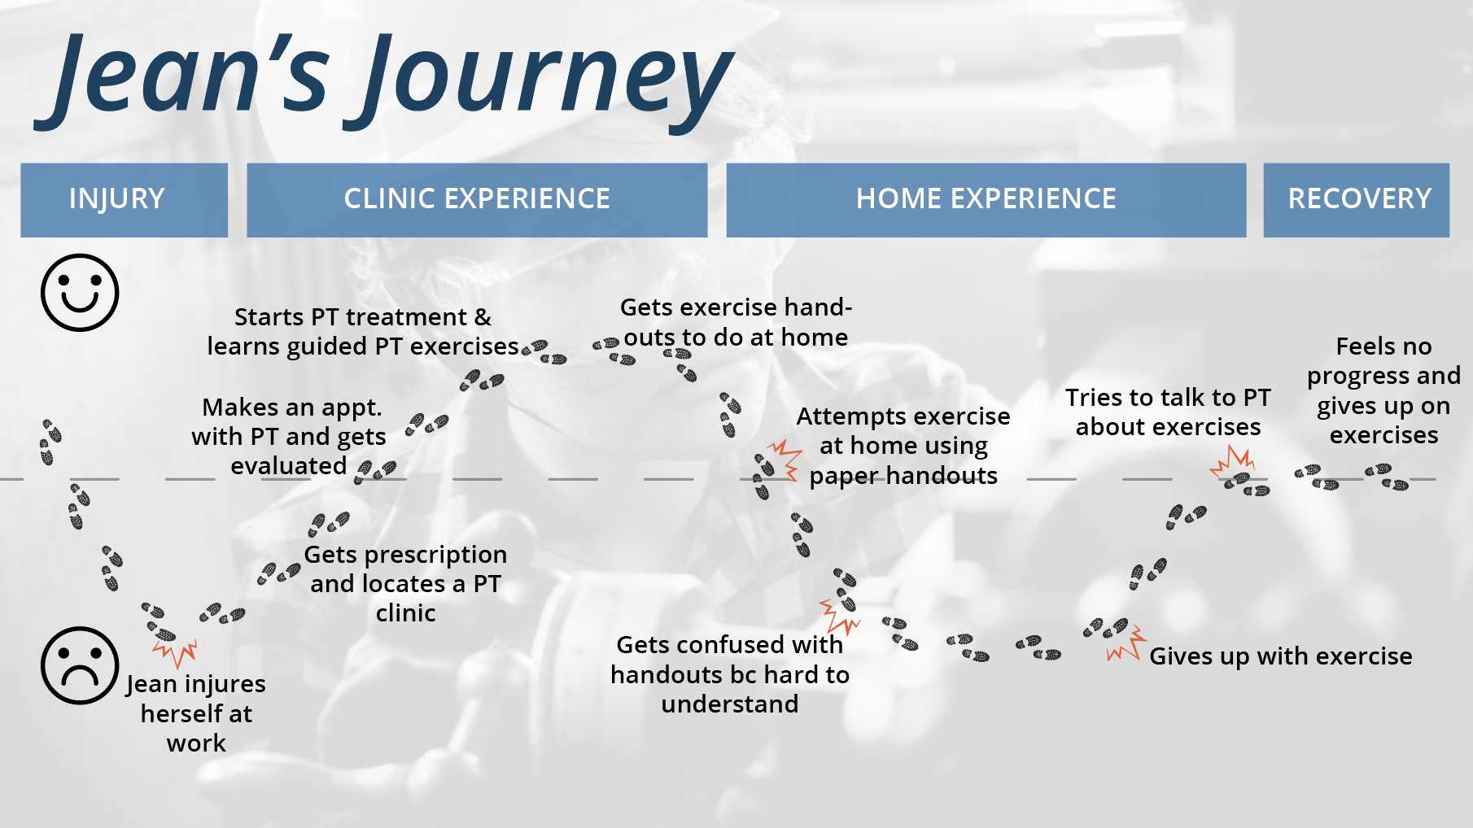
Notes:
SPEAKER: JOANNA

Slide 7
Problem Statement
Physical therapy patients often struggle to complete their prescribed regimen at home.
Jean recently injured herself at work. At the clinic, the physical therapist gives her clear instructions and support. However, at home, she is unsure of what to do when performing the prescribed regimen.
How might we provide Jean additional resources she needs to complete her at-home regimen successfully and track her progress?
Notes:
SPEAKER: JOANNA

Slide 8
Competitive Matrix
Personalized
MedBridge GO for Patients
Kaia
PT involved
Physera
PT not involved
Generic
Notes:
SPEAKER: JOANNA
All of our interviewees said they wanted a physical therapist to keep them accountable for performing exercises at home, so we put Thera in the left of the X-axis. And since many of our interviewees had a hard time following generic paper handouts of exercises to do at home, we wanted to make a physical therapy app that was unique to each user and placed Thera at the top of the Y-axis.

Slide 9

Our Platform & Partner
A patient-focused native mobile app that helps users do their PT regimen at home successfully.
Thera has the following features:
Workout reminders
Personalized home exercise routines
Progress tracker.
A physical therapist-focused software provider with over 40% market share in the outpatient rehab space.
Notes:
SPEAKER: JOANNA
By partnering with WebPT, Thera ensures the continuity of care for patients and physical therapists in and outside of the clinic.

Slide 10
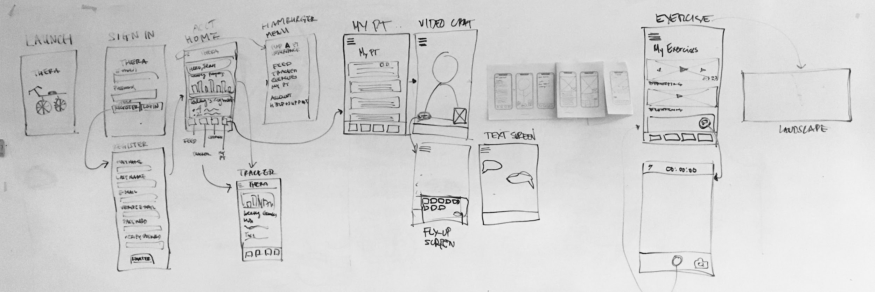
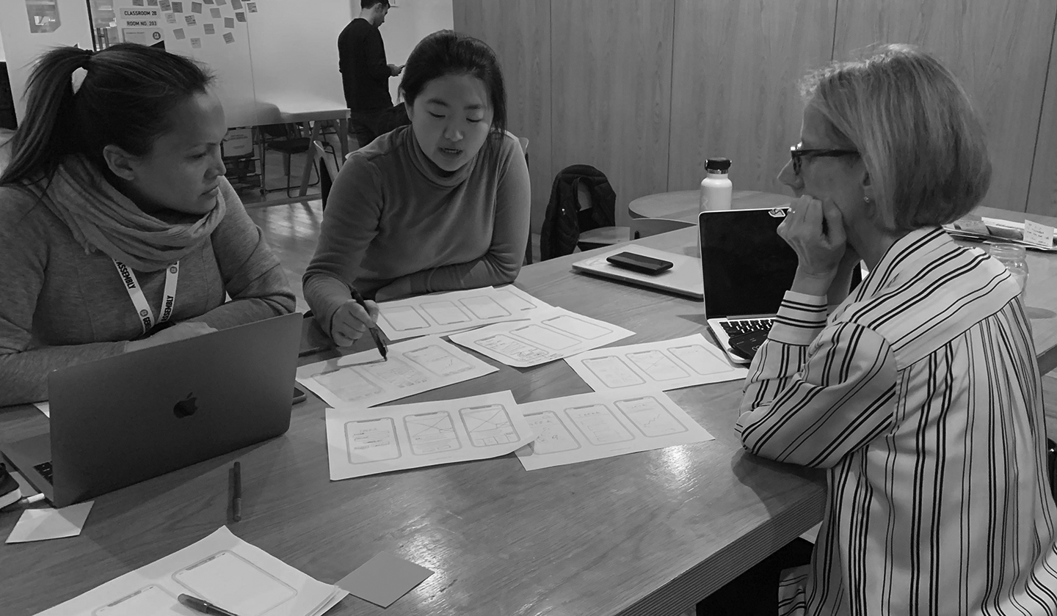
Design Studio | DIVERGE ➤ PITCH ➤ ITERATE ➤ CONVERGE
MUST
Progress Tracker
Personalized Exercise Videos
Video Chat
Choi | McFarlane | Rider | Tobias
Notes:
SPEAKER: SIMONE
Now that you have been introduced to jean and walked through her journey, I would like to take you along our design process.
Our task of designing a solution to the problem became easier as our research revealed what ARE the MUST have features
A feature where the user can track her rehabilation progress
Personalized exercise videos that she can easily follow
Thirdly, a video chat feature where she can speak one-on-one with her pt
As Joanna previously mentioned, these features are already available amongst our competitors, but our entry into the market is adding that next level of personalization. Physical Therapy, as Jackie mentioned earlier, is incredibly personal, and we want our users to know that she can have that personal experience at home using Thera with her smartphone.

Slide 11
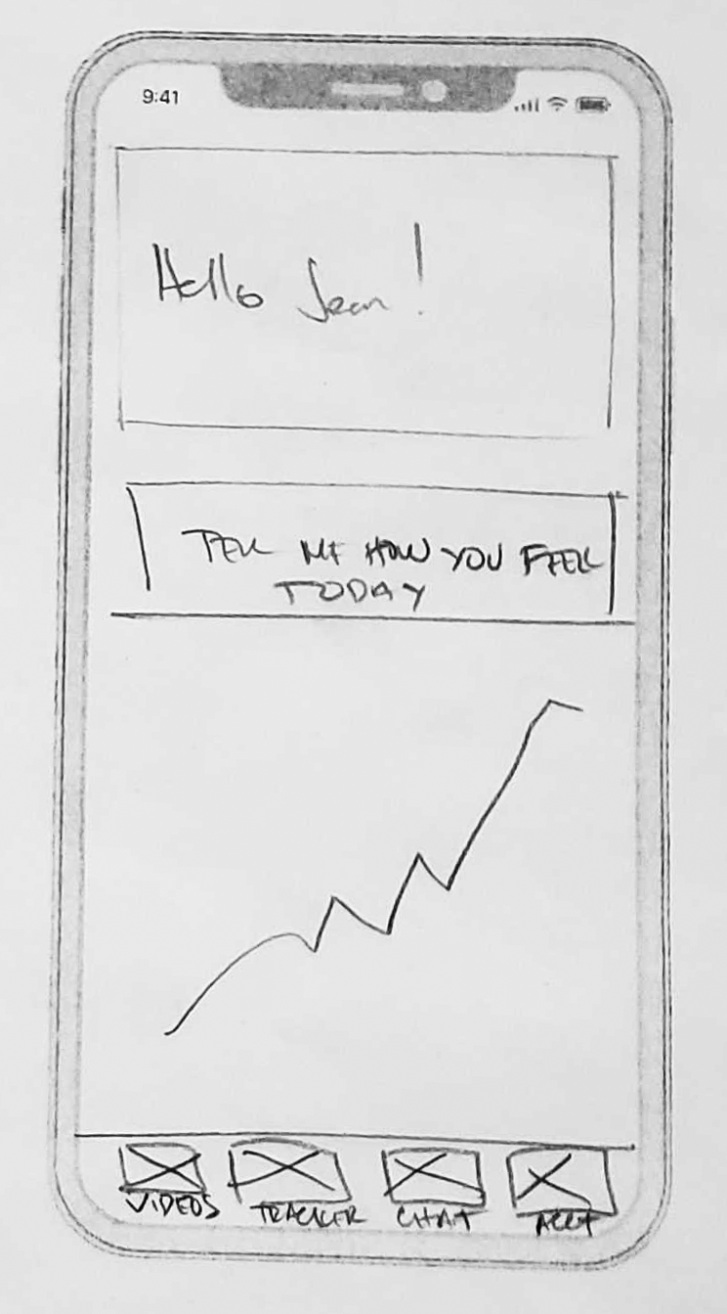
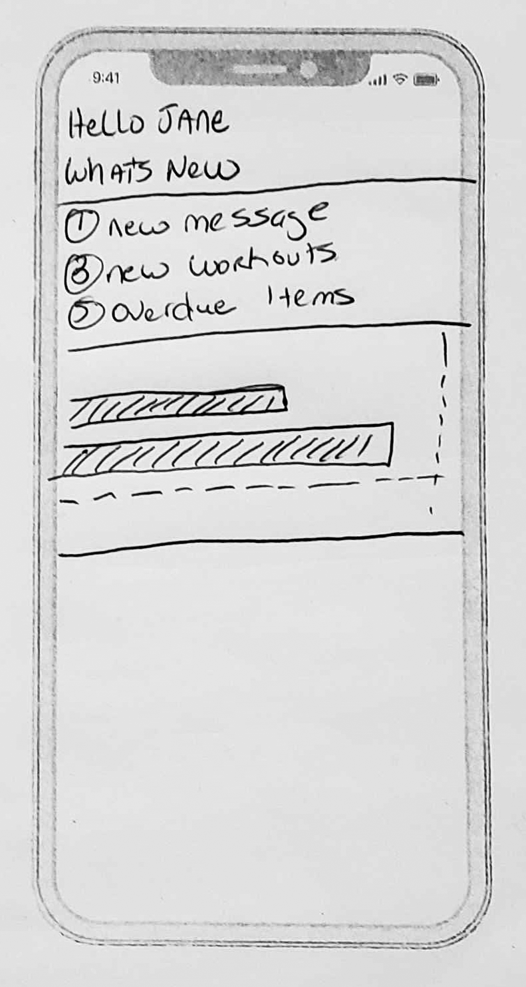
Design Studio | PROGRESS TRACKER
Design
Must include personal progress tracker
Data
4 out of 6 users had no idea if they were making any progress
Design Ideas: Progress Tracker
Notes:
SPEAKER: SIMONE
Based on the insights we gathered from our user interviews, we decided we must include the following features:
Progress Tracker: 4 out of 6 users had no idea if they were making any progress.
Personalized Exercise Videos: 4 out of 6 users said they were given paper handouts of exercises to do at home, which they ended up not doing because they still did not know how to do the exercises.
Video Chat: 4 out of 6 interviewees said they would like to have communicated more with their physical therapists outside of their session.
Create an Account: so that people can have personalized exercise

Slide 12
Design Studio | PROGRESS TRACKER
Design
Must include personal progress tracker
Data
4 out of 6 users had no idea if they were making any progress
I couldn’t follow my progress at home
Design Ideas: Progress Tracker
Notes:
SPEAKER: SIMONE
Based on the insights we gathered from our user interviews, we decided we must include the following features:
Progress Tracker: 4 out of 6 users had no idea if they were making any progress.
Personalized Exercise Videos: 4 out of 6 users said they were given paper handouts of exercises to do at home, which they ended up not doing because they still did not know how to do the exercises.
Video Chat: 4 out of 6 interviewees said they would like to have communicated more with their physical therapists outside of their session.
Create an Account: so that people can have personalized exercise

Slide 13
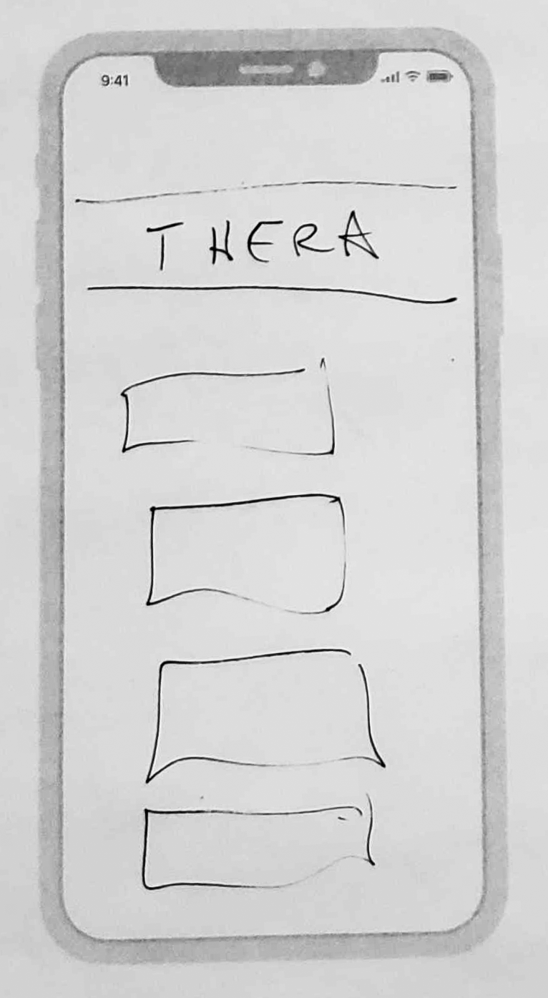
Design Studio | PERSONAL EXERCISE VIDEOS
Design
Must create easy to follow personal exercise videos
Data
4 out of 6 users said they were given hard to follow/confusing paper handouts of home exercises
“I was unsure if I was doing them correctly, so I stopped the exercises and didn’t improve.”
-User Quote
Design Ideas: Personal Exercise Video Library
Notes:
SPEAKER: SIMONE
Based on the insights we gathered from our user interviews, we decided we must include the following features:
Progress Tracker: 4 out of 6 users had no idea if they were making any progress.
Personalized Exercise Videos: 4 out of 6 users said they were given paper handouts of exercises to do at home, which they ended up not doing because they still did not know how to do the exercises.
Video Chat: 4 out of 6 interviewees said they would like to have communicated more with their physical therapists outside of their session.
Create an Account: so that people can have personalized exercise

Slide 14
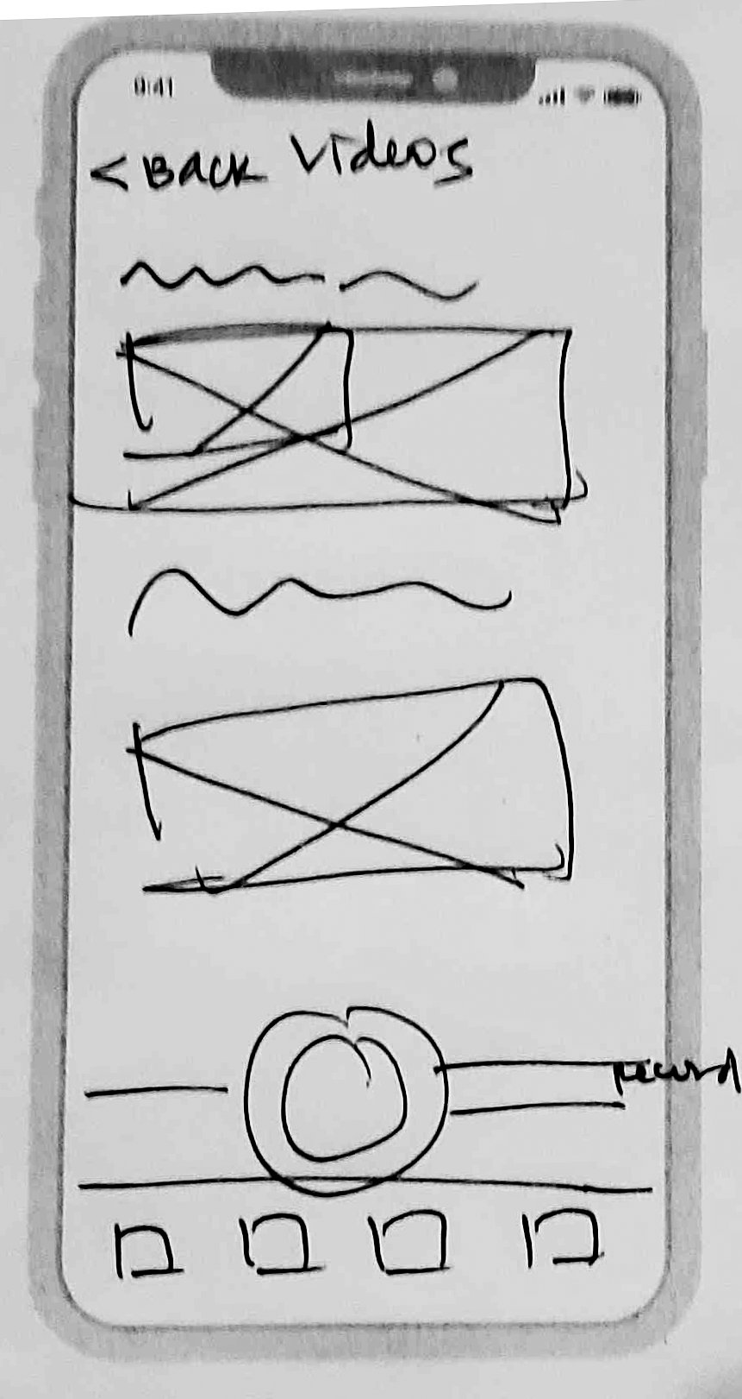
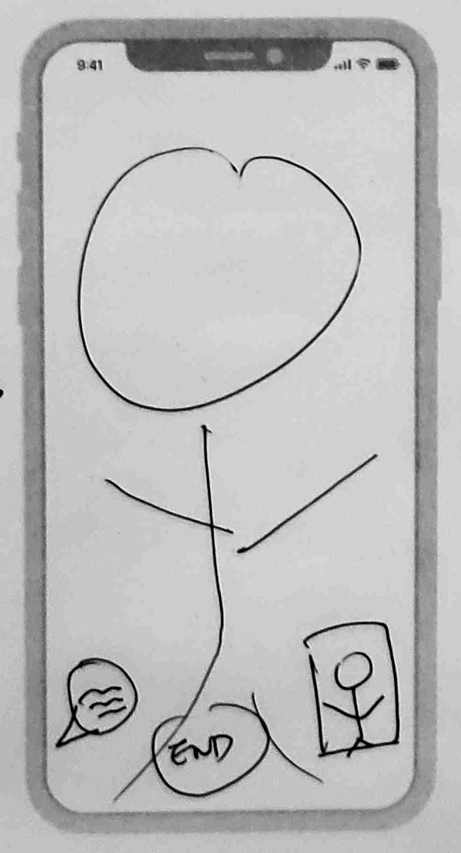
Design Studio | VIDEO CHAT
Design
Must be able to video chat or communicate one-on-one with PT
Data
4 out of 6 interviewees said they would like more communication with their PT outside the clinic visits.
Design Ideas: Video Chat Feature
Notes:
SPEAKER: SIMONE
Based on the insights we gathered from our user interviews, we decided we must include the following features:
Progress Tracker: 4 out of 6 users had no idea if they were making any progress.
Personalized Exercise Videos: 4 out of 6 users said they were given paper handouts of exercises to do at home, which they ended up not doing because they still did not know how to do the exercises.
Video Chat: 4 out of 6 interviewees said they would like to have communicated more with their physical therapists outside of their session.
Create an Account: so that people can have personalized exercise

Slide 15
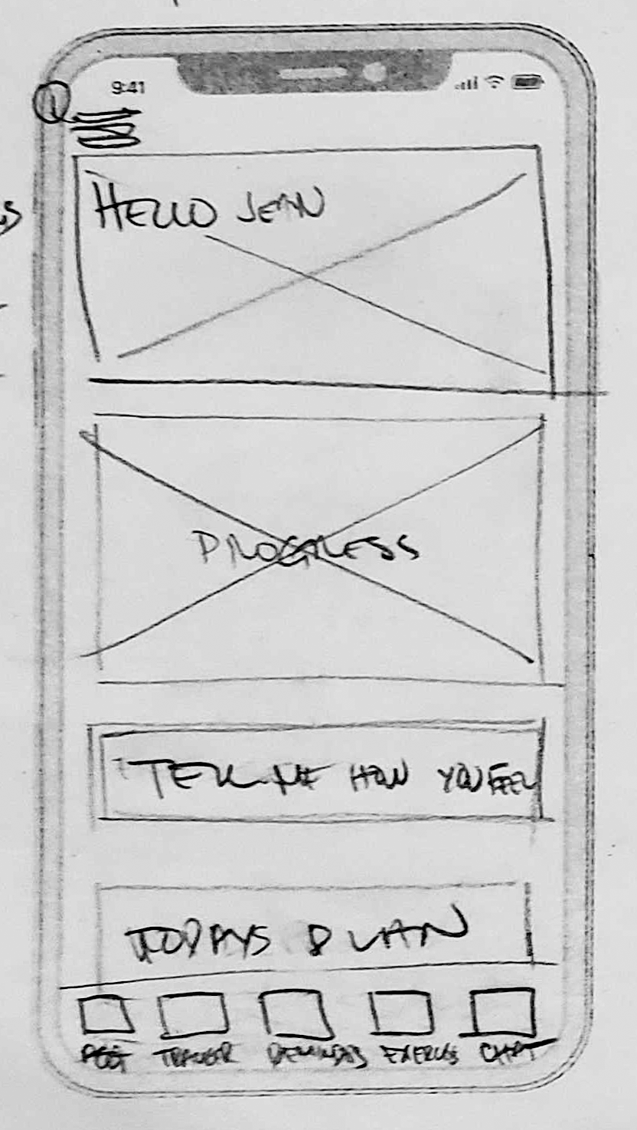
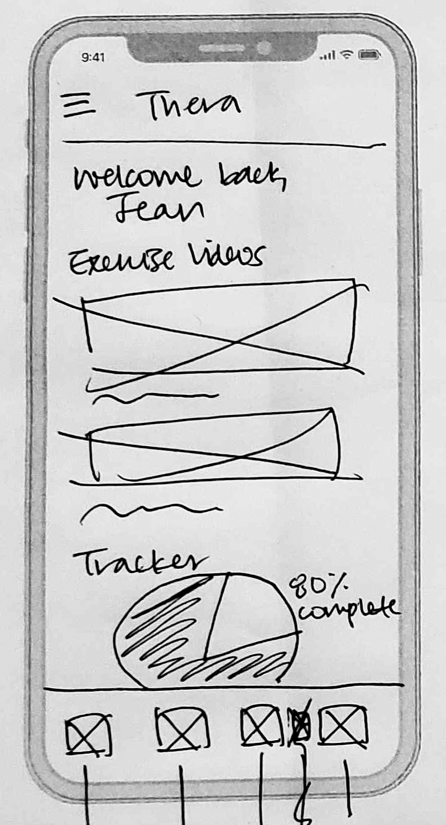
Design Studio | HOME SCREEN
Design MUSTs
Home Screen with Summary of Personal Progress Tracker
Quick Overview of Personalized Exercise Videos
Easy Navigation to One-on-One Video Chat
1
1
2
2
3
3
Design Ideas: Home Screen
Notes:
SPEAKER: SIMONE
Im going to pass it on to my colleague Dwayne so he can walked you through the mid-fidelity prototype and you can see how we have taken these designs to the next level.

Slide 16
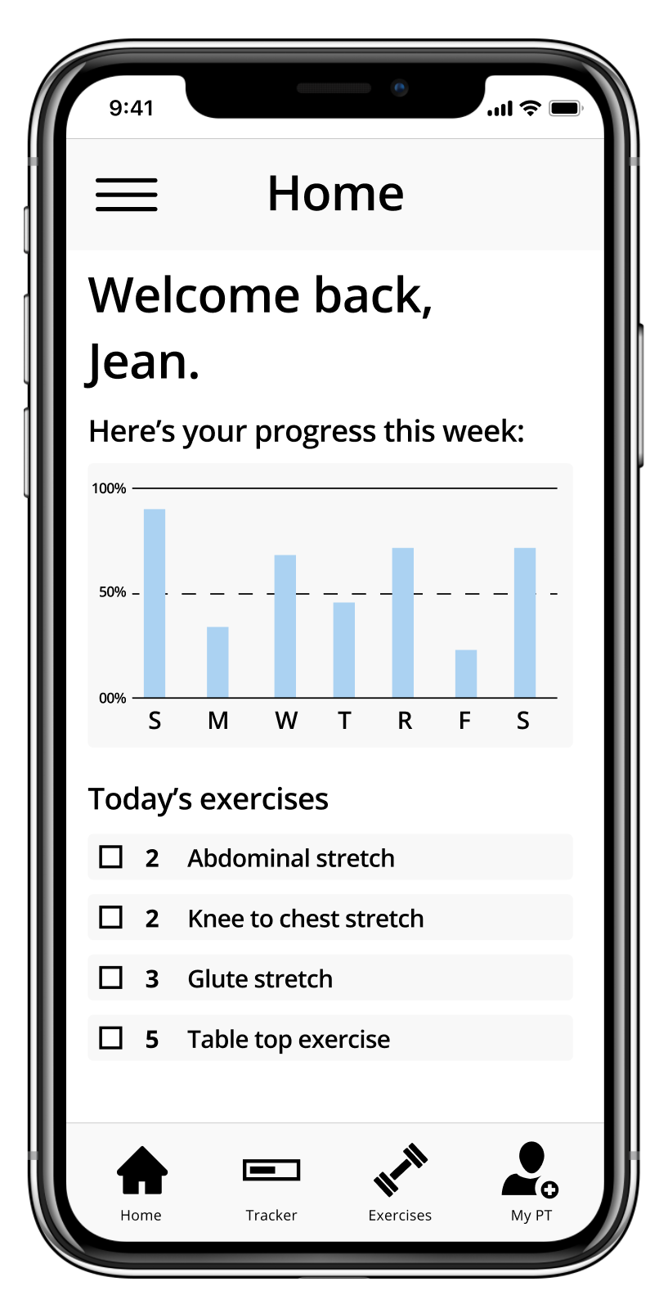
Mid-Fi Prototype | Annotations - Home
1
Snapshot view of exercise completion.
Listing of exercise regimen due for current day.
Quick Access - Detailed Progress Tracker
Quick Access - Exercises - View listing of all PT.
Quick Access - MyPT - View listing of all PT.
2
1
3
4
2
5
3
4
5
Home screen

Slide 17
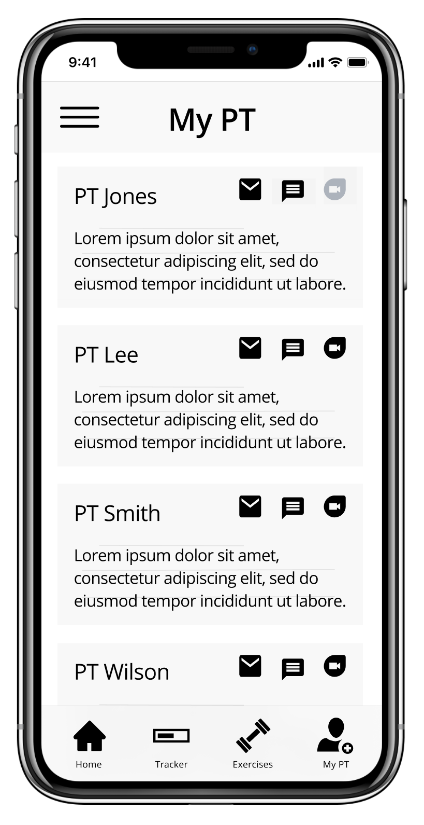
Mid-Fi Prototype | Annotations - Message PT
1
Physical Information
Quick Contact - Email
Quick Contact - Message
Quick Contact - Videochat
1
2
2
3
4
3
4
My PT Screen

Slide 18
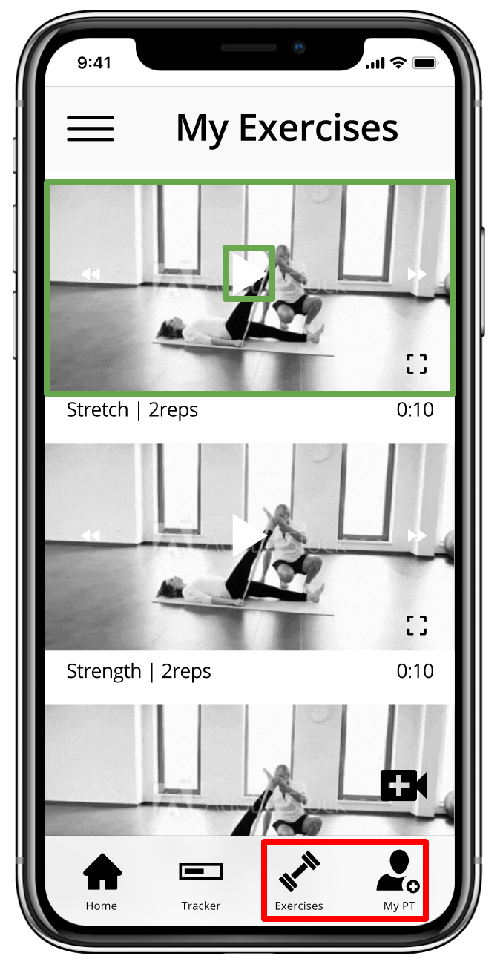
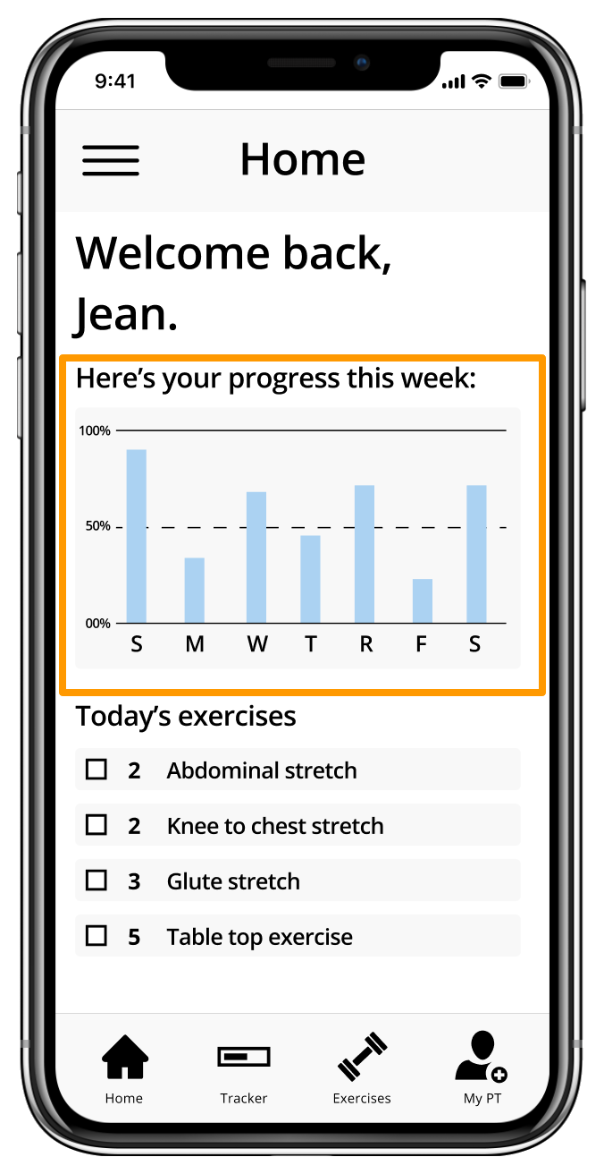
Mid-Fi Prototype | User Testing 1
Scenario: You need to do your physical therapy today. Your physical therapist recorded a video of you doing the exercise correctly.
Task: Watch the pre-recorded video of you doing your exercise correctly.
3/4 Passed
The Good
Login/Registration
Icon Placement
Exercise Layout
1/4 Failed
Hiccups
Onboarding Screen
Tracker Utility
Layout/Findability
My Exercises and Home screens
Notes:
SPEAKER: Dwayne

Slide 19
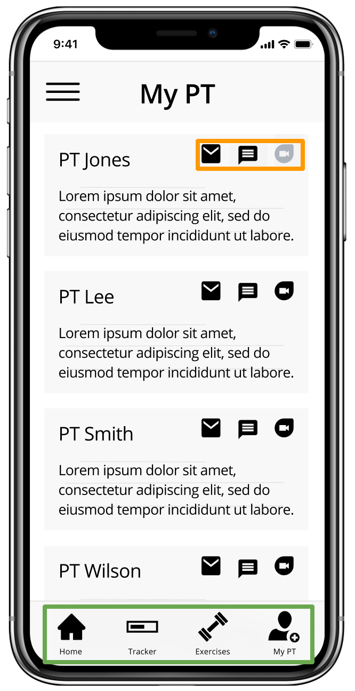
Mid-Fi Prototype | User Testing 2
Scenario: You want to talk to your physical therapist about the progress you have made.
Task: Contact your physical therapist, PT Jones.
4/4 Passed
The Good
Icon Placement
PT Layout
0/4 Failed
Hiccups
Too Many PT on Page
PT Contact Icons
MyPT screen
Notes:
SPEAKER: Dwayne

Slide 20
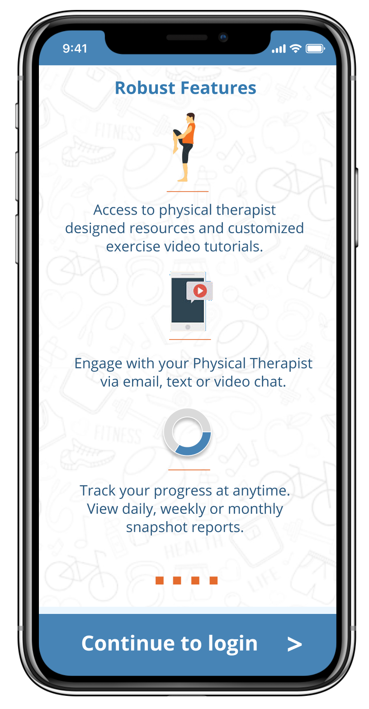
Hi-Fi Prototype | Updated Design - Onboarding
1
Removed circle background for clearer image.
Added carousel navigation for linked pages.
Escape option to proceed directly to app.
2
1
3
2
3
Onboarding screen

Slide 21
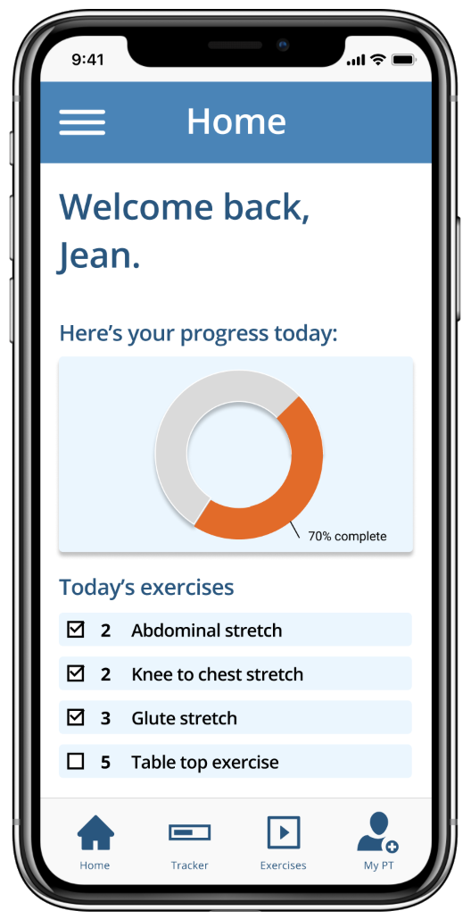
Hi-Fi Prototype | Updated Design - Home
1
Redesigned tracking to immediately convey progress.
Changed icon for Exercises.
2
1
1
2
Home screen

Slide 22
Next Steps
Conduct a second round of usability testing for the high-fidelity prototype
Edit the prototype based on feedback from usability testing
Build out connection with partner company WebPT
Hand off to developers
Choi | McFarlane | Rider | Tobias

